Slide 1
Introduction to MESSAGE-ix
Görkem Güngör
E-mail: ggungor@enerji.gov.tr

Slide 2
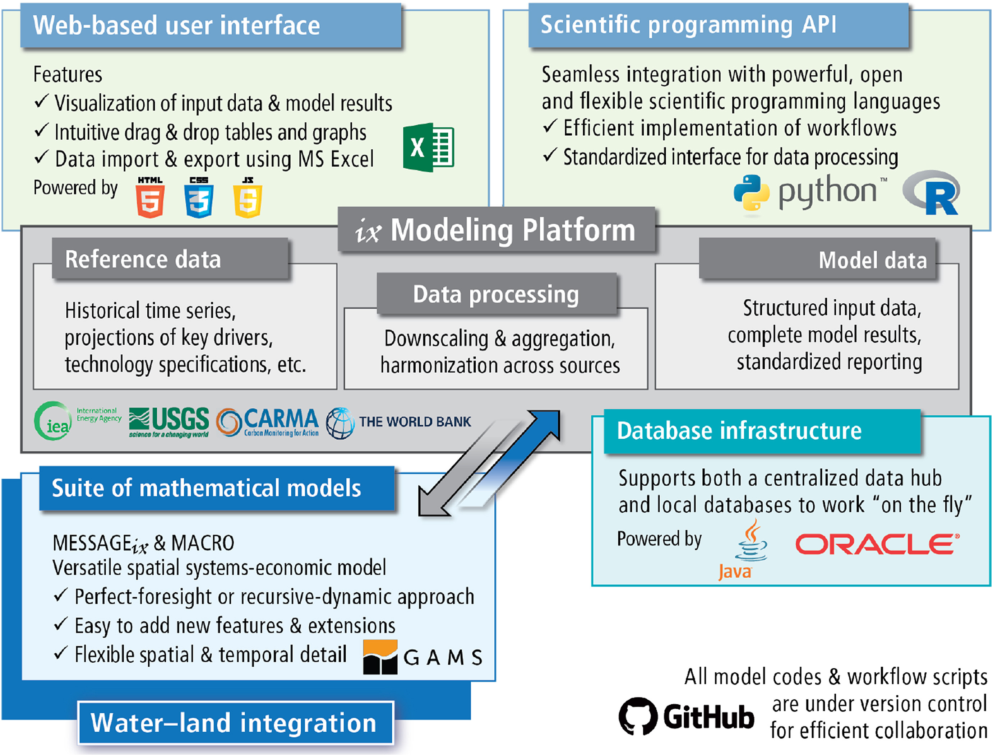
Energy Modeling Platform
Compensate the shortcomings on transparency, control and repeatability of previous models
Usage of Python functions in Jupyter Notebook for creating an instance of the modeling platform
Usage of GAMS solvers for optimization (requires version and license validity)
Communication in Java between interfaces
Notes:
Huppmann, D., Gidden, M., Fricko, O., Kolp, P., Orthofer, C., Pimmer, M., Kushin, N., Vinca, A., Mastrucci, A., Riahi, K., & Krey, V. (2019). The MESSAGE Integrated Assessment Model and the ix modeling platform (ixmp): An open framework for integrated and cross-cutting analysis of energy, climate, the environment, and sustainable development. Environmental Modelling & Software, 112(March 2018), 143–156. https://doi.org/10.1016/j.envsoft.2018.11.012
https://youtu.be/vJ6G0ry884Y

Slide 3
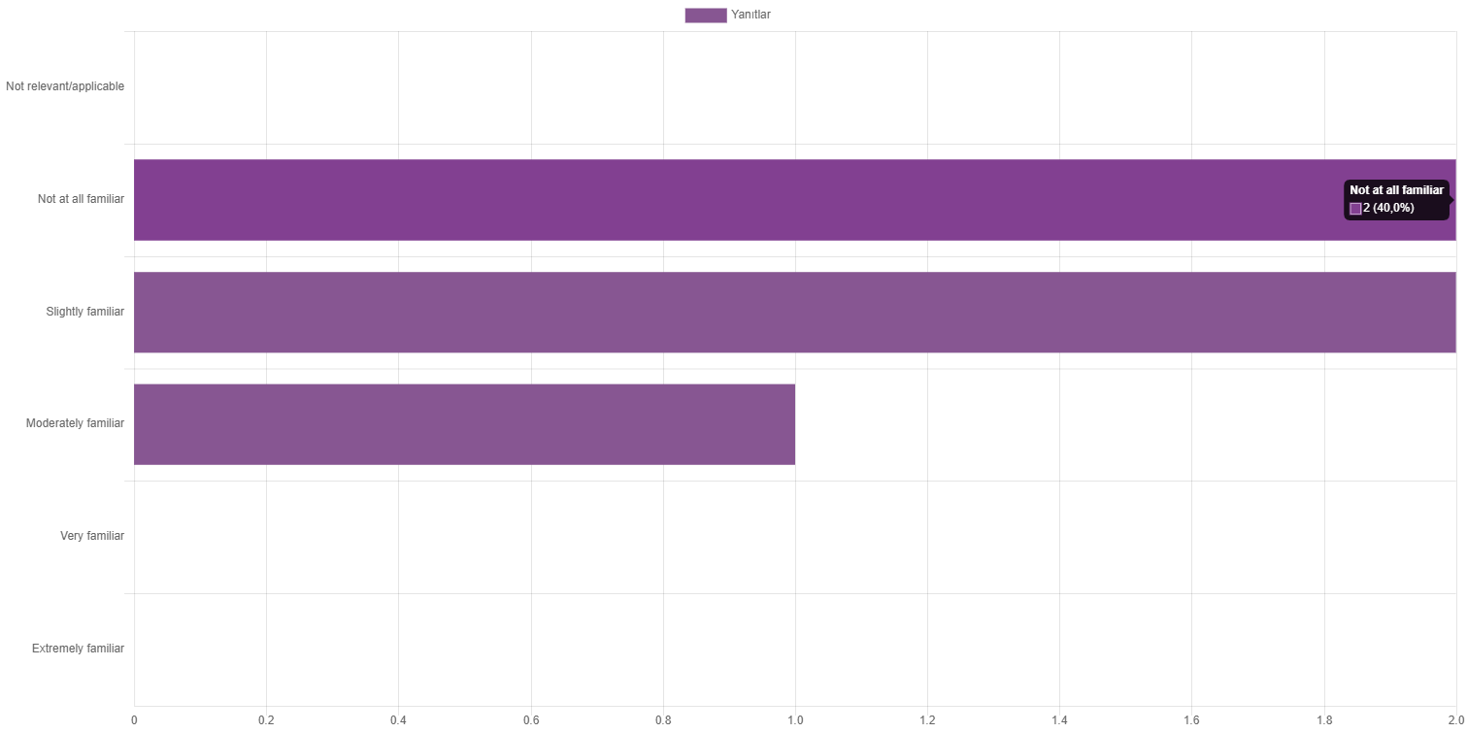

Background and experience with scientific programming
How familiar, if at all, are you with these programs?

Slide 4
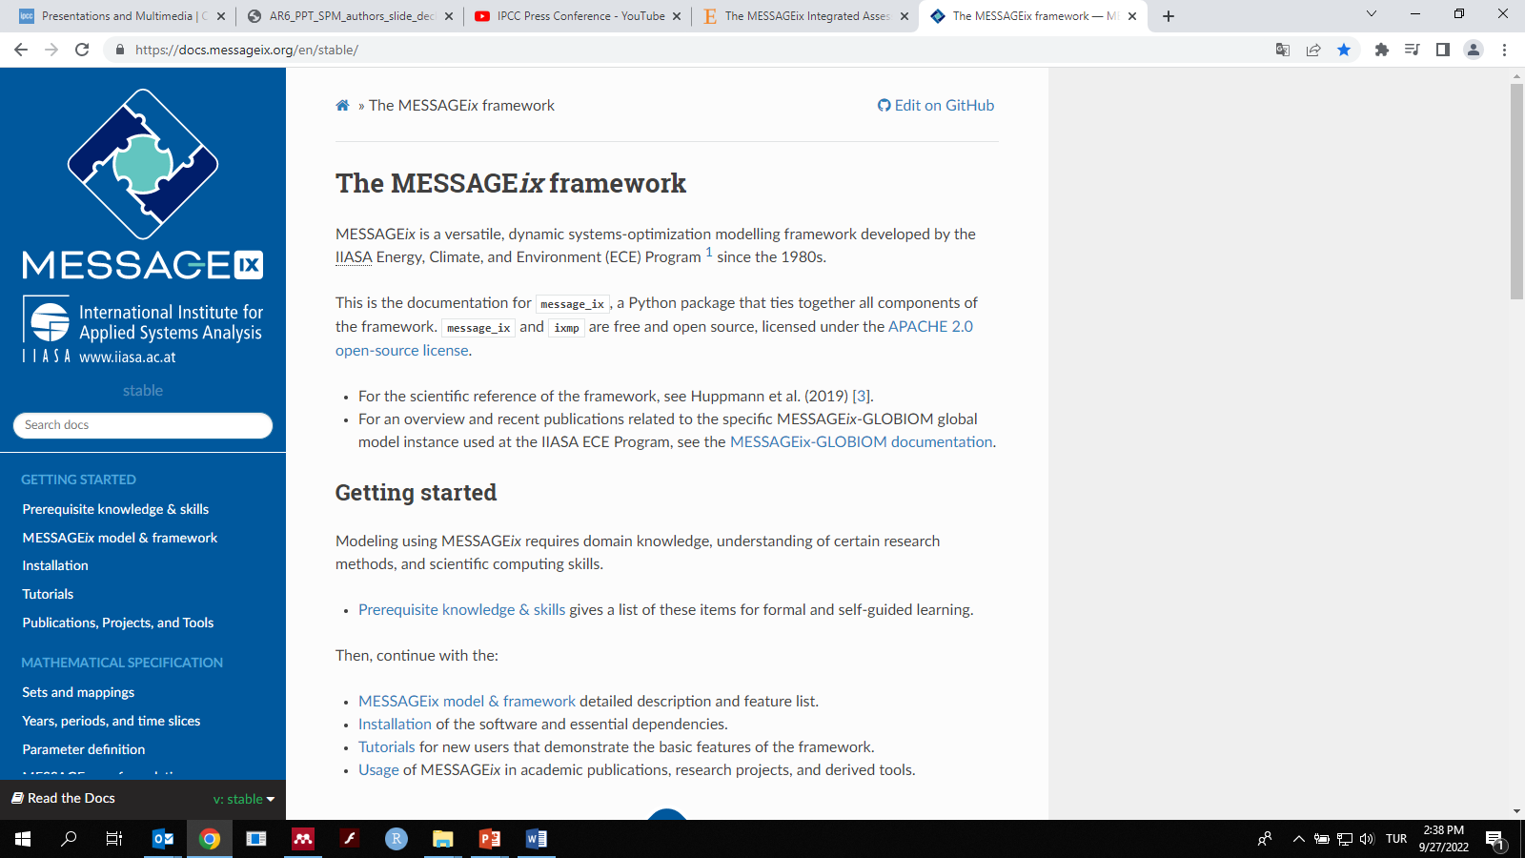
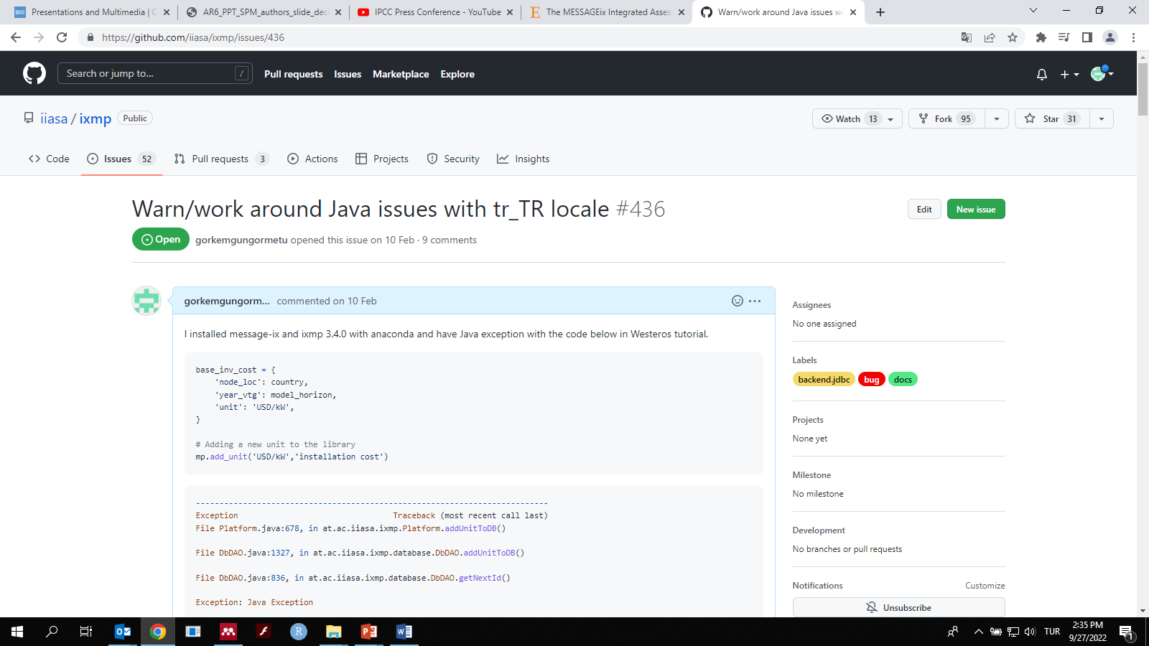
Model Development
Issues raised by contributors developing or using the software code
The document is integrated and kept sychronized with the software code
Training modules for model application aiming to increase interest of young researchers
Notes:
https://github.com/iiasa/ixmp/issues/436
https://docs.messageix.org/en/stable/
https://iiasa.github.io/ene-present.github.io/cnrs-2018/#/6

Slide 5
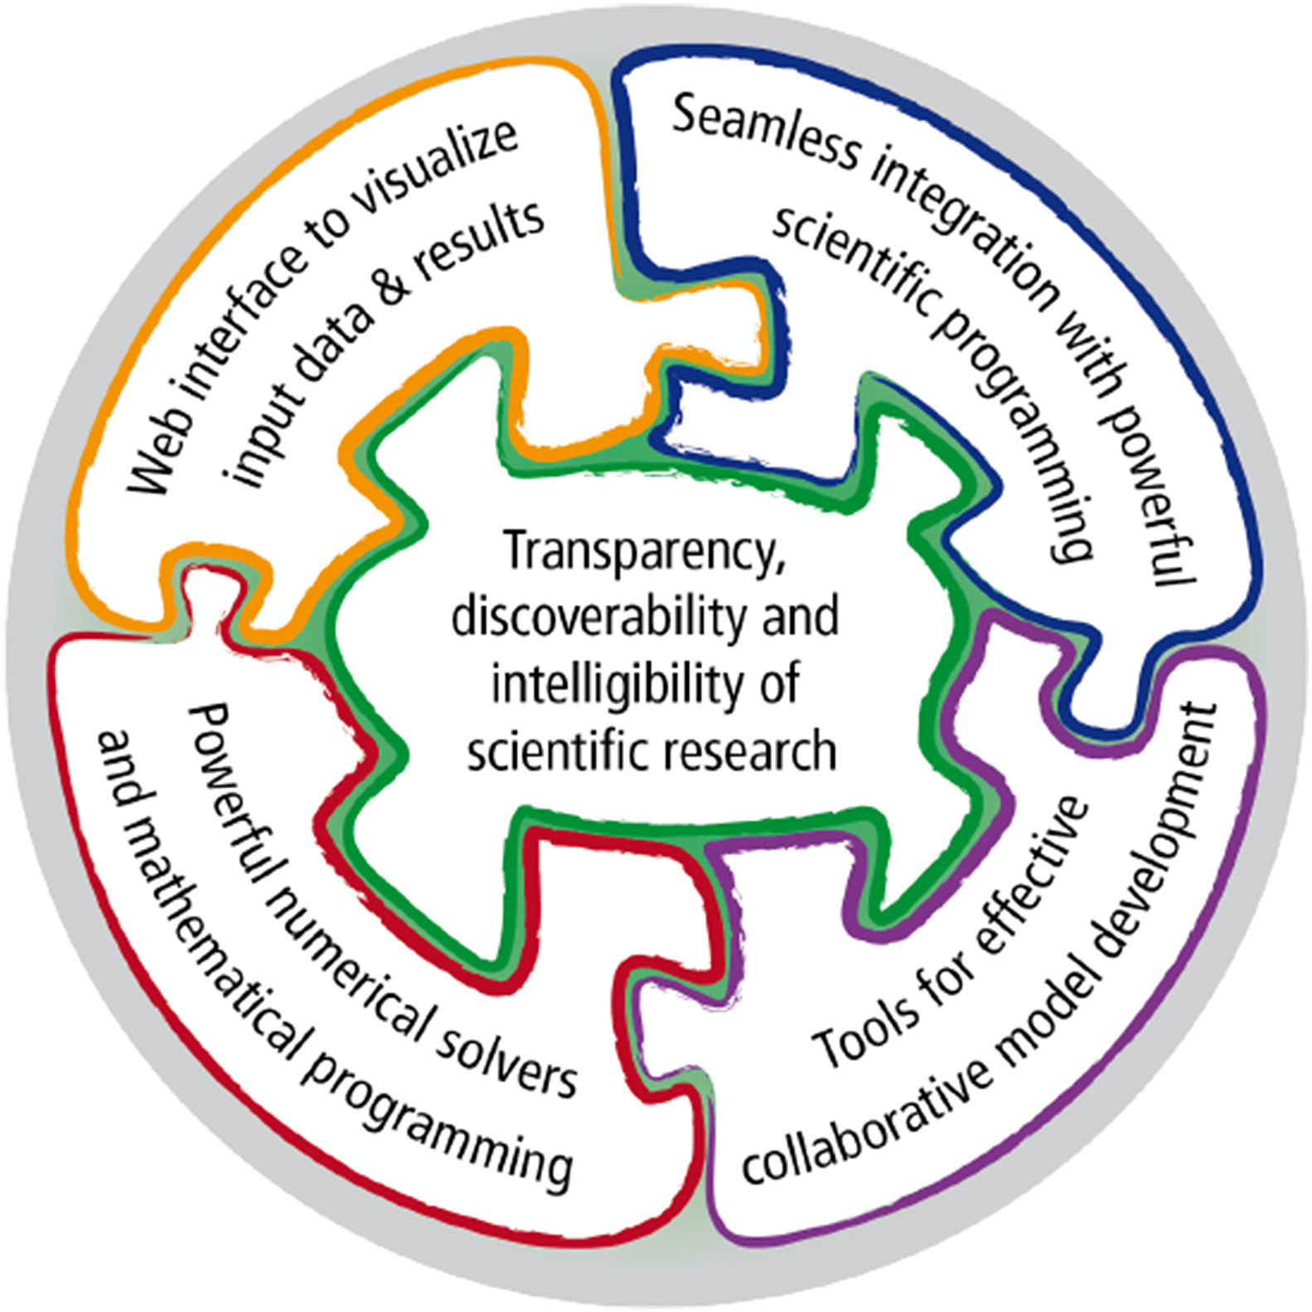
MESSAGE-MACRO
A least-cost systems optimization program integrated with a general-economy model
A Java back-end linked to a database architecture for data management
Interfaces to the scientific programming languages Python and R for data processing
A REST API for standardized data exchange using web services
A user interface accessible via any web browser for model/scenario management and data/results analysis
Notes:
REST: representational state transfer

Slide 6



Installation of MESSAGEix
Be sure to install Anaconda from https://www.anaconda.com/products/distribution or Miniconda from https://docs.conda.io/en/latest/miniconda.html
GAMS program from https://www.gams.com/download/ and the community license
Follow the tutorial video from workshop tutorial https://youtu.be/vJ6G0ry884Y or the installation steps from https://docs.messageix.org/en/stable/install.html

Slide 7
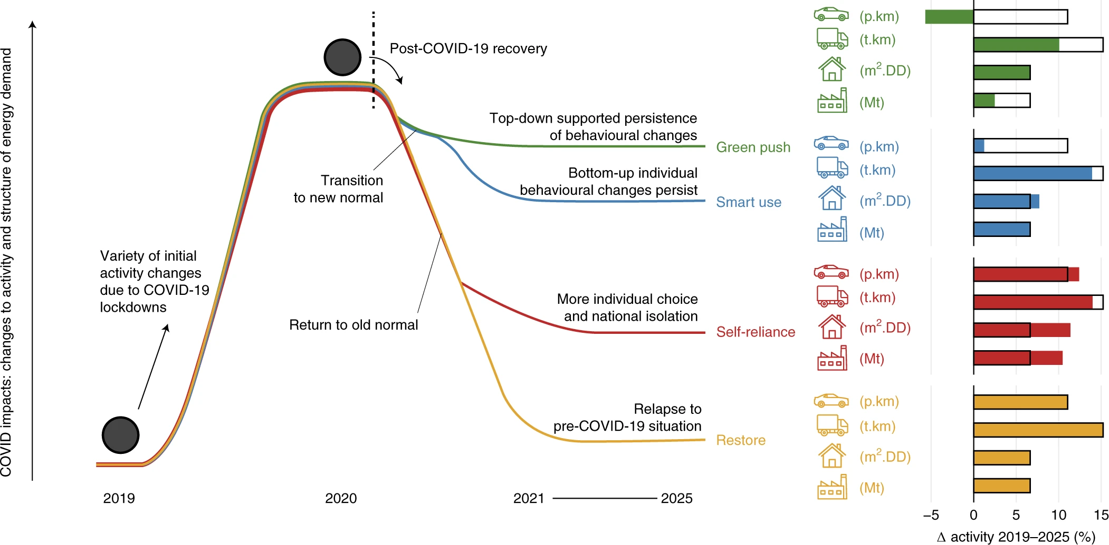
Scenario Analysis: Impact of Covid-19 to Energy Policies
This paper provides an assessment of bottom-up shock from COVID-19 pandemic to the baseline energy pathway
The direct effect of the COVID-19 pandemic lockdowns on global emissions is negligible in the context of climate mitigation
Seizing opportunities for maintaining energy demand changes (green push) can increase the probability of achieving the climate target
Note that the y axis denotes disturbance compared with pre-pandemic ‘normality’ and not an increase in demand. Bar charts show relative changes in energy-related activity between 2019 and 2025 in passenger mobility (car icon), freight transport (truck icon), buildings (residential and non-residential; house icon) and industrial sectors (factory icon) for the four recovery pathways. The black outline boxes indicate the 2019–2025 change in the ‘restore’ scenario (yellow) and serve as a common reference point for the ‘self-reliance’, ‘smart use’ and ‘green push’ scenarios (red, blue and green, respectively). Indicators are passenger-kilometre (p.km), tonne-kilometre (t.km), metre squared-degree days (m².DD) and material production in million tonnes (Mt). This image has been designed using resources from Freepik.com.
Notes:
Kikstra, J. S., Vinca, A., Lovat, F., Boza-Kiss, B., van Ruijven, B., Wilson, C., Rogelj, J., Zakeri, B., Fricko, O., & Riahi, K. (2021). Climate mitigation scenarios with persistent COVID-19-related energy demand changes. Nature Energy, 6(12), 1114–1123. https://doi.org/10.1038/s41560-021-00904-8

Slide 8
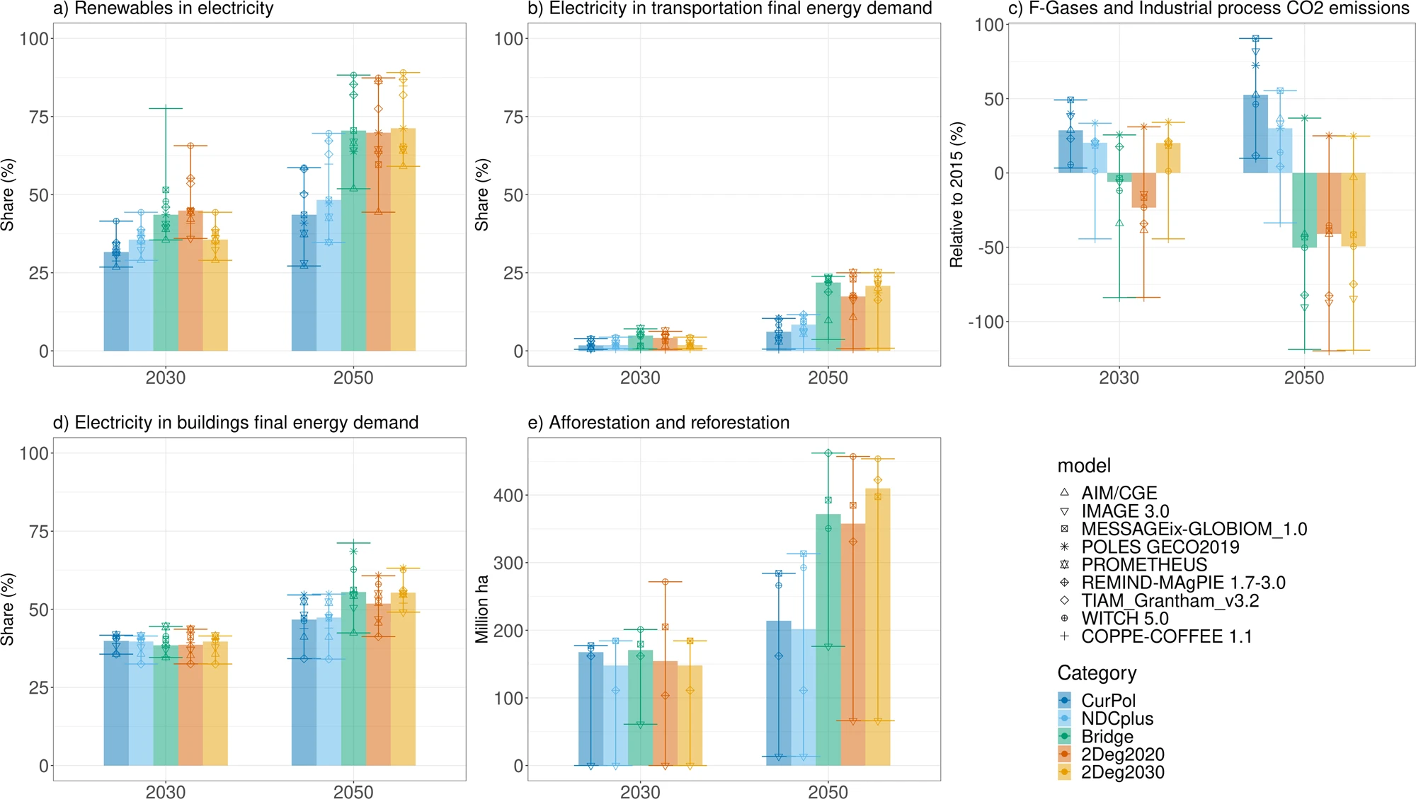
Scenario Analysis: Spillover Effect from Climate Action
The paper recommends a Bridge scenario to spread the climate action from the forerunners to late comers
The Bridge scenario closes two-thirds of the emissions gap between NDC and 2°C scenarios by 2030
Early action with good-practice policies is less costly than a delay in global climate cooperation
Notes:
van Soest, H. L., Aleluia Reis, L., Baptista, L. B., Bertram, C., Després, J., Drouet, L., den Elzen, M., Fragkos, P., Fricko, O., Fujimori, S., Grant, N., Harmsen, M., Iyer, G., Keramidas, K., Köberle, A. C., Kriegler, E., Malik, A., Mittal, S., Oshiro, K., … van Vuuren, D. P. (2021). Global roll-out of comprehensive policy measures may aid in bridging emissions gap. Nature Communications, 12(1), 6419. https://doi.org/10.1038/s41467-021-26595-z

Slide 9
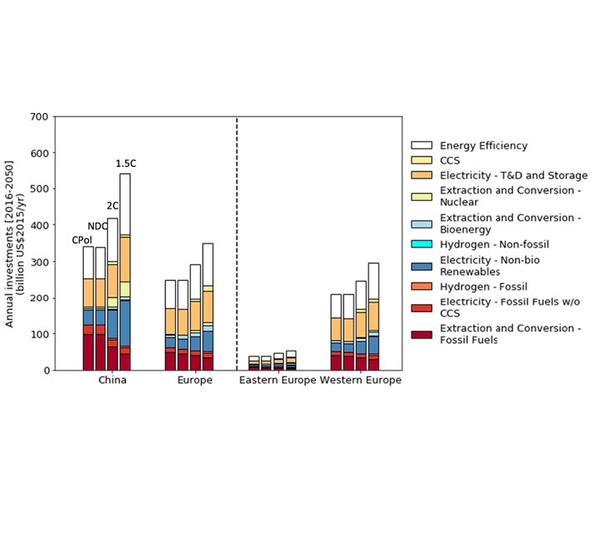
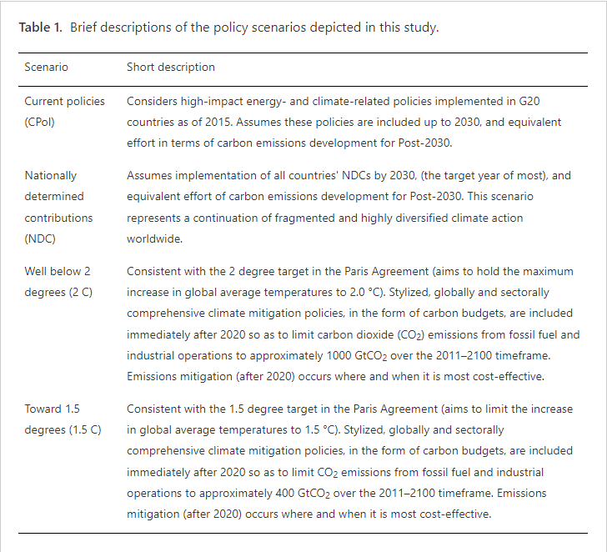
Scenario Analysis: Regional Low Carbon Investments
The paper compares the decarbonization investments based on energy scenarios between China and Europe.
Despite increasing investments into low-carbon sectors in two regions, the gaps are still large to keep their efforts on track with the global climate targets.
Energy efficiency, renewable electricity generation and electricity transmission and distribution might be identified as the key areas of investment.
Notes:
Zhou, W., McCollum, D. L., Fricko, O., Gidden, M., Huppmann, D., Krey, V., & Riahi, K. (2019). A comparison of low carbon investment needs between China and Europe in stringent climate policy scenarios. ENVIRONMENTAL RESEARCH LETTERS, 14(5), 054017. https://doi.org/10.1088/1748-9326/ab0dd8

Slide 10
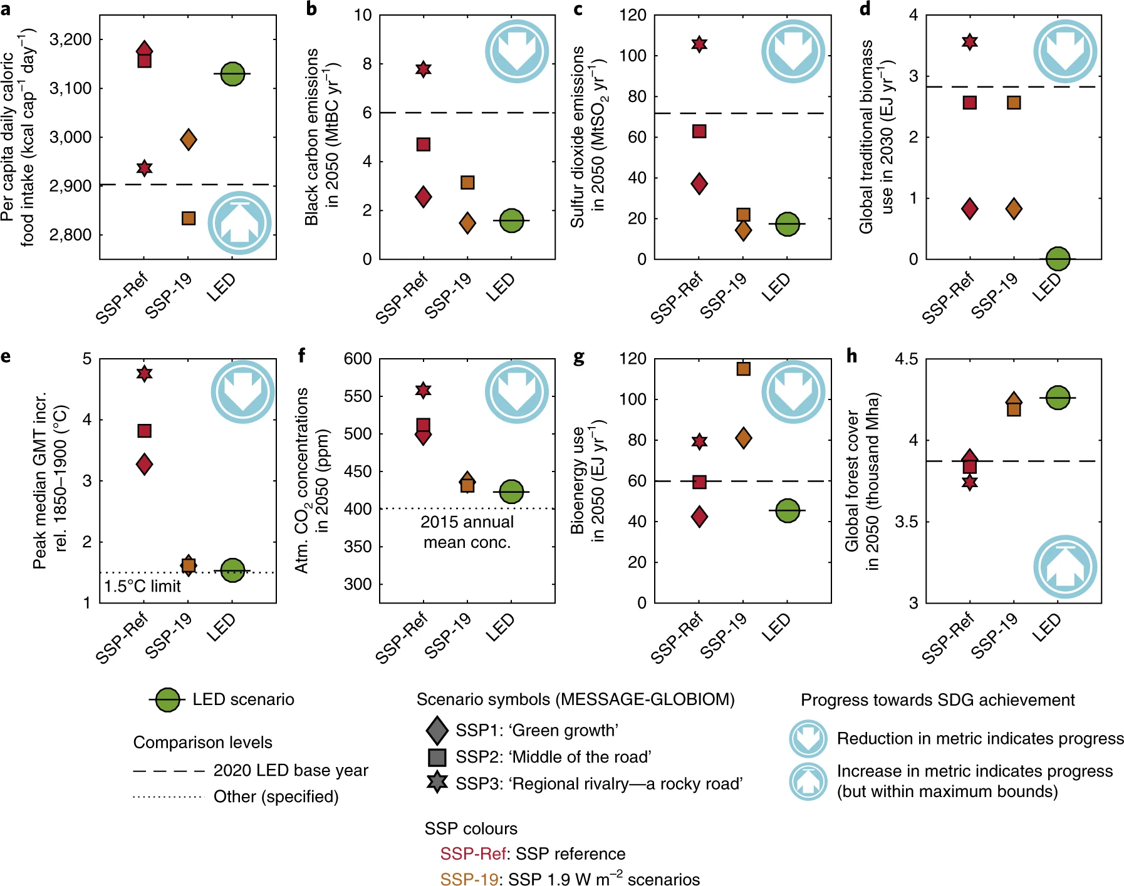
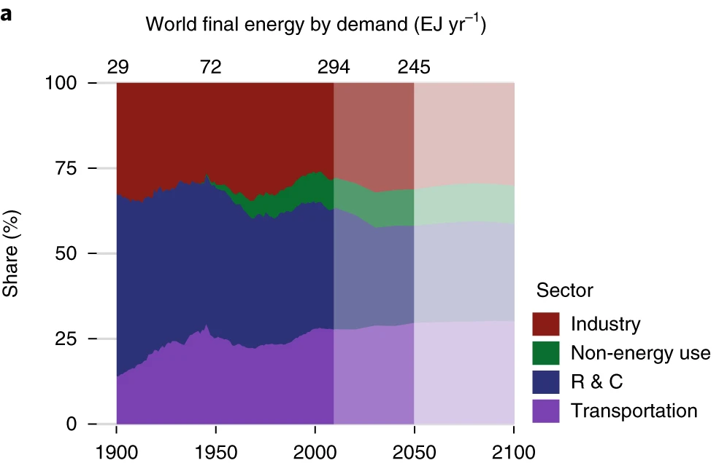
Scenario Analysis: Meeting the 1.5 °C target and SDGs
Extension of IIASA GEA study for Low Energy Demand (LED) scenario
Supply side investments are reduced with socio-economical transition of useful energy demand.
Energy efficiency is the key to achieving a range of climate and development goals synergistically
LED outcomes translate into important benefits for SDGs on poverty, hunger, health, energy, climate and oceans, and land
Notes:
Grubler, A., Wilson, C., Bento, N., Boza-Kiss, B., Krey, V., McCollum, D. L., Rao, N. D., Riahi, K., Rogelj, J., De Stercke, S., Cullen, J., Frank, S., Fricko, O., Guo, F., Gidden, M., Havlík, P., Huppmann, D., Kiesewetter, G., Rafaj, P., … Valin, H. (2018). A low energy demand scenario for meeting the 1.5 °C target and sustainable development goals without negative emission technologies. Nature Energy, 3(6), 515–527. https://doi.org/10.1038/s41560-018-0172-6

Slide 11
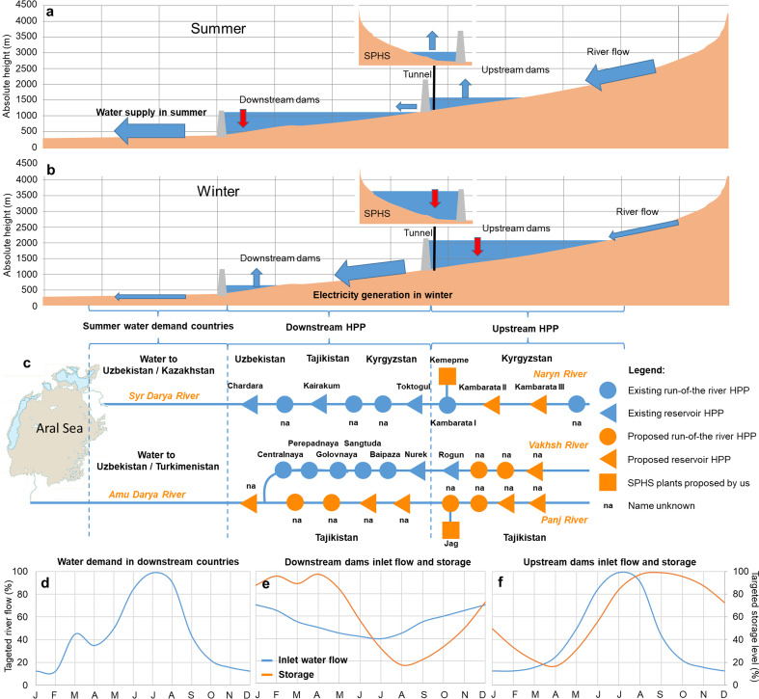
Case Study: Energy and Water Security in Central Asia
The paper illustrates the usage of seasonal pumped hydro storage plants in upstream and downstream countries of Central Asia for optimization of energy and water usage.
The water cycle in Central Asia is also sensitive to demands for agriculture and supply from glazier which are vulnerable against climate change.
Notes:
Zakeri, B., & Syri, S. (2015). Electrical energy storage systems: A comparative life cycle cost analysis. Renewable and Sustainable Energy Reviews, 42, 569–596. https://doi.org/10.1016/j.rser.2014.10.011

Slide 12
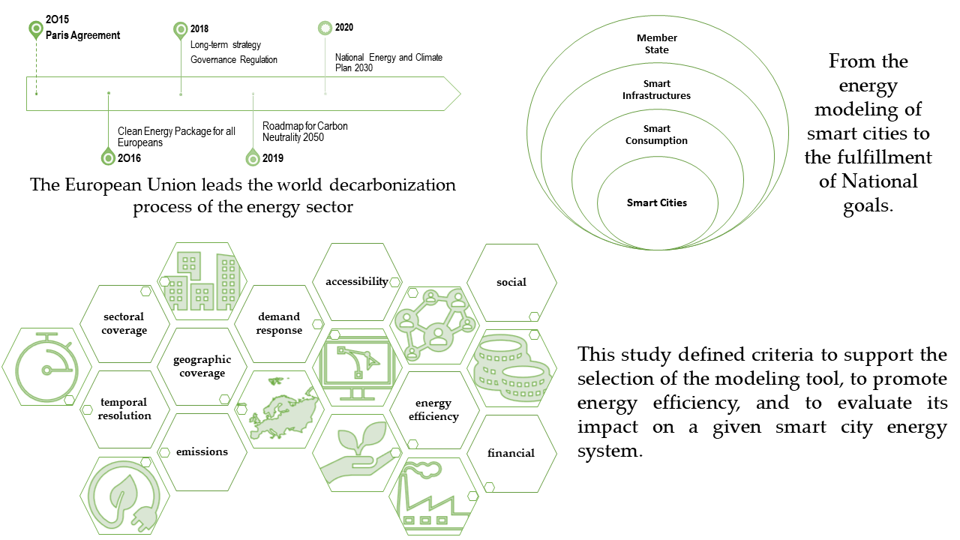
Case Study: Energy Efficiency in Smart Cities
The paper reviews the open-source energy modeling tools for city energy systems analysis.
The criteria could be considered together with the FAIR principle which the author did not mention.
The sorting to distribute model alternatives using a multiple-criteria decision method includes energy efficiency, demand response measures, open-source/paid model and geographic coverage.
Notes:
Martins, F., Patrão, C., Moura, P., & de Almeida, A. T. (2021). A Review of Energy Modeling Tools for Energy Efficiency in Smart Cities. Smart Cities, 4(4), 1420–1436. https://doi.org/10.3390/smartcities4040075

Slide 13
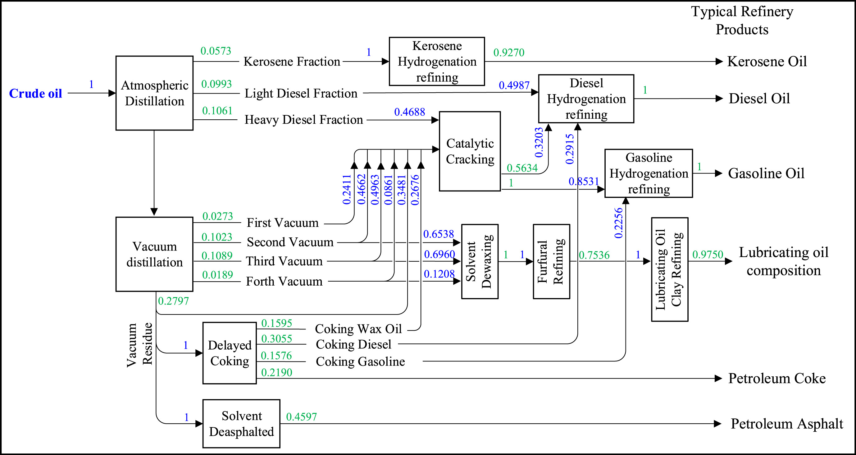
Case Study: Climate Mitigation of China’s Petroleum Industry
Development of an oil refinery model from well-to-wheels using MESSAGEix for China
Analysis of strategies for deep decarbonization using energy and water efficiency improvements.
Energy efficiency measures and a carbon price are necessary for climate mitigation
Carbon capture and storage could have a direct effect on CO2 emission reduction
Notes:
Zhao, F., Fan, Y., & Zhang, S. (2021). Assessment of efficiency improvement and emission mitigation potentials in China’s petroleum refining industry. Journal of Cleaner Production, 280(2), 124482. https://doi.org/10.1016/j.jclepro.2020.124482

Slide 14
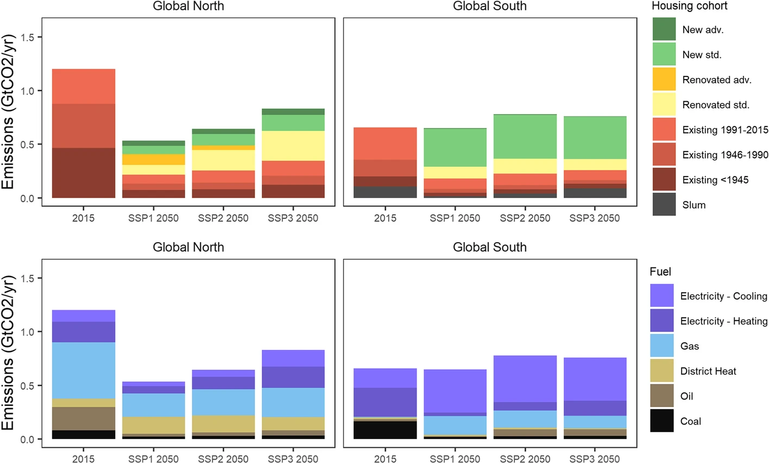
Case Study: Residential Heating and Cooling Scenarios
This paper presents the results of building sector model for the world based on SSPs and considering both heating-cooling and building stock turnover.
The rapid turnover of buildings in Centrally Planned Asia requires addressing energy efficiency primarily in new construction
Renovations are key in the global north due to slower building replacement rates
CO₂ emissions in the base year (2015) and for SSP1-3 (2050) in the global north and south: breakdown by energy efficiency cohort (top panel) and fuels (bottom panel)
Notes:
Mastrucci, A., van Ruijven, B., Byers, E., Poblete-Cazenave, M., & Pachauri, S. (2021). Global scenarios of residential heating and cooling energy demand and CO2 emissions. Climatic Change, 168(3–4), 14. https://doi.org/10.1007/s10584-021-03229-3

Slide 15
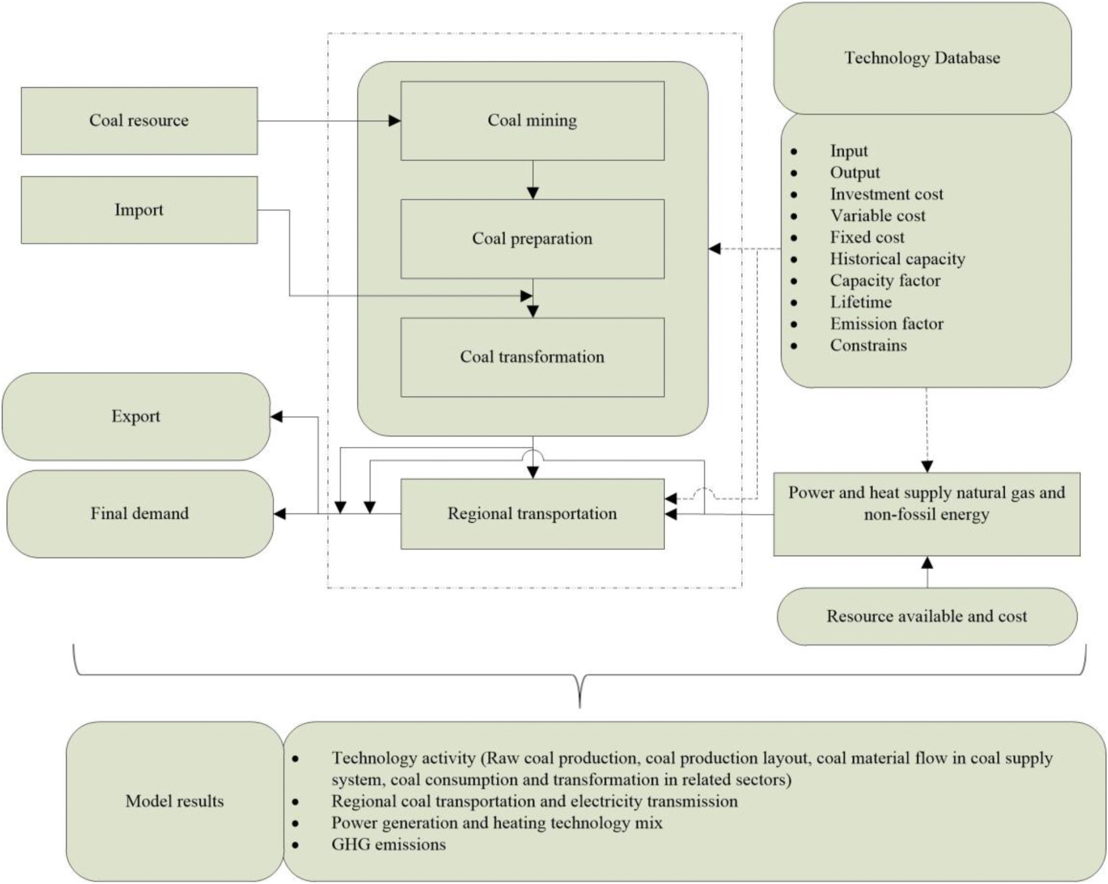
Case Study: The Future of Coal Supply in China
The paper provides a scenario analysis for coal demand in China considering baseline and carbon tax pathways.
The results of the optimization model reveal that national raw coal production in China will peak in 2030 at 3791 Mt under the baseline scenario
Carbon price and the development of renewable energy system have a significant effect on coal supply
Notes:
Jie, D., Xu, X., & Guo, F. (2021). The future of coal supply in China based on non-fossil energy development and carbon price strategies. Energy, 220, 119644. https://doi.org/10.1016/j.energy.2020.119644

Slide 16
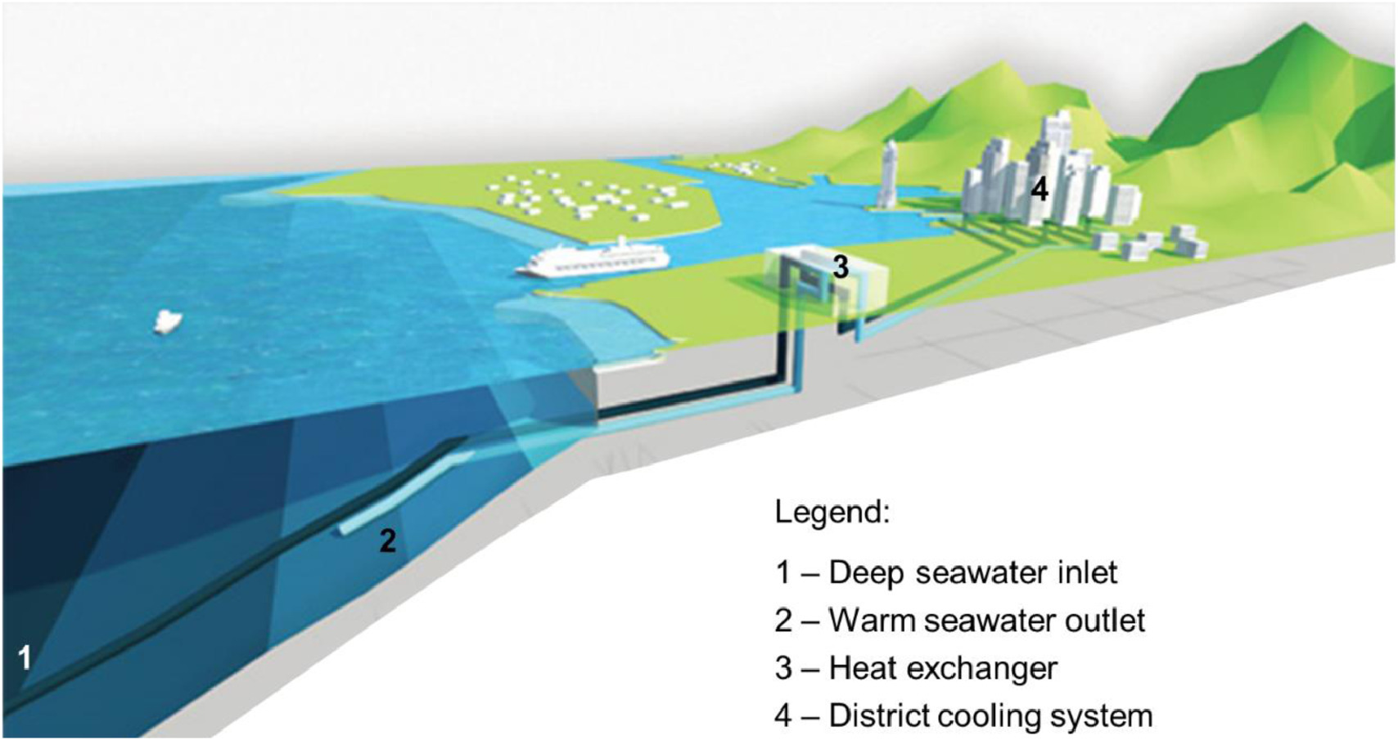
Case Study: District Cooling and Desalination with Sea Water
Benchmark of sea-water cooling in buildings using a modified energy system model with energy storage
MESSAGEix energy system modeling tool is used to simulate Male´s cooling and water services demand
Deep seawater cooling and desalination is a technically feasible renewable energy alternative in island or coastal tropical and equatorial regions with pressing water scarcity
Notes:
Hunt, J. D., Weber, N. de A. B., Zakeri, B., Diaby, A. T., Byrne, P., Filho, W. L., & Schneider, P. S. (2021). Deep seawater cooling and desalination: Combining seawater air conditioning and desalination. Sustainable Cities and Society, 74(August). https://doi.org/10.1016/j.scs.2021.103257

Slide 17
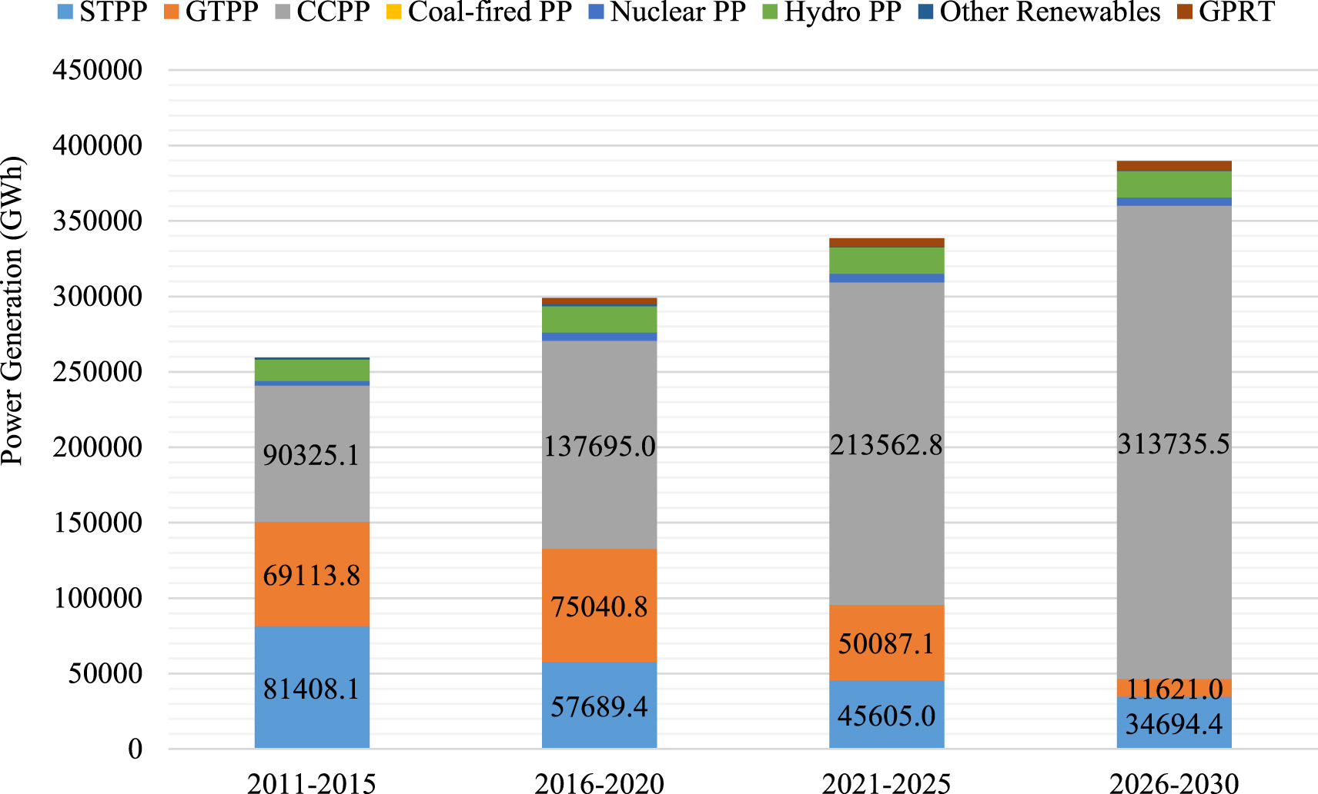
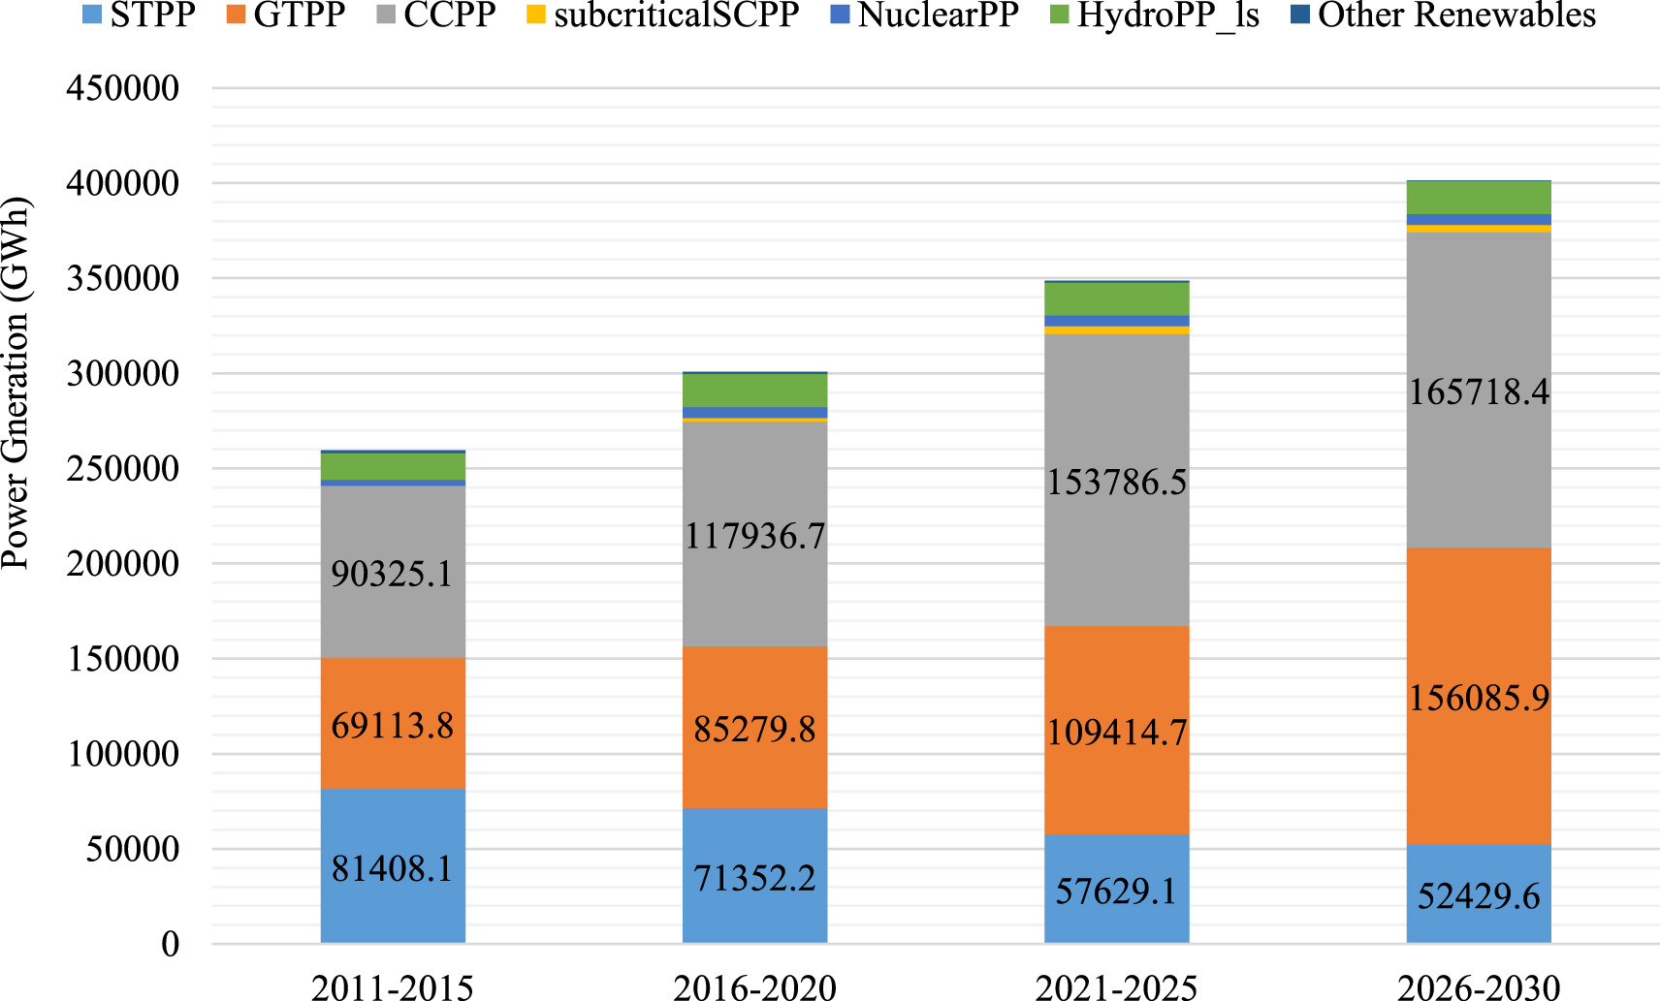
Case Study: Energy Supply Transformation Pathways for Iran
Energy supply model for Iran using MESSAGEix for fossil fuel resource efficiency and cost optimization
“Policies-on-ice” scenario assumes limited investment on energy efficiency improvement and utilizing aging inefficient technologies
“Policies-in-hand” scenario assumes frictionless technology diffusion and unlimited cost-effective investment in energy efficiency improvement
The power generation mix in the policies-in-hand scenario in 5-years periods
The power generation mix in the policies-on-ice scenario in 5-years periods
Notes:
Ghadaksaz, H., & Saboohi, Y. (2020). Energy supply transformation pathways in Iran to reduce GHG emissions in line with the Paris Agreement. Energy Strategy Reviews, 32, 100541. https://doi.org/10.1016/j.esr.2020.100541
STPP: Steam türbine power plant, GTPP: gas turbine power plant, CCPP: combined cycle power plant, GPRT:

Slide 18
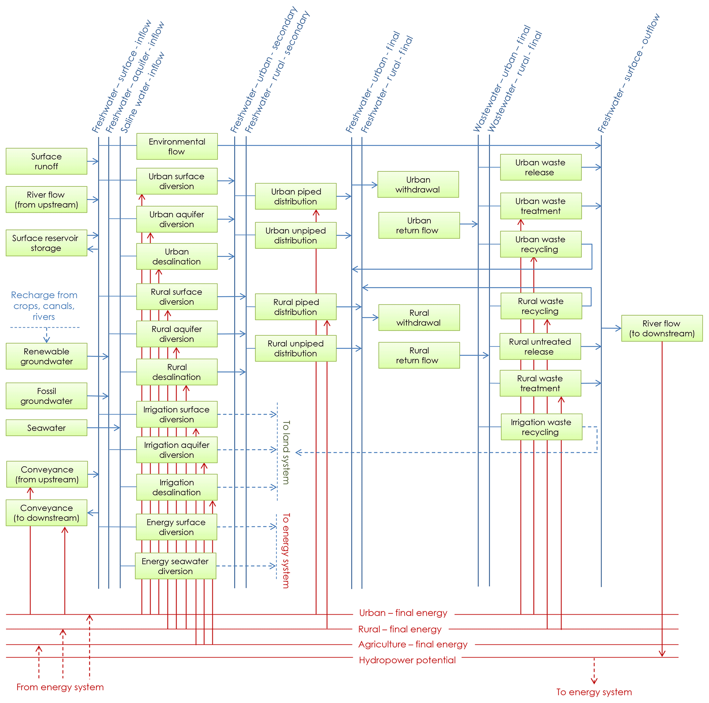
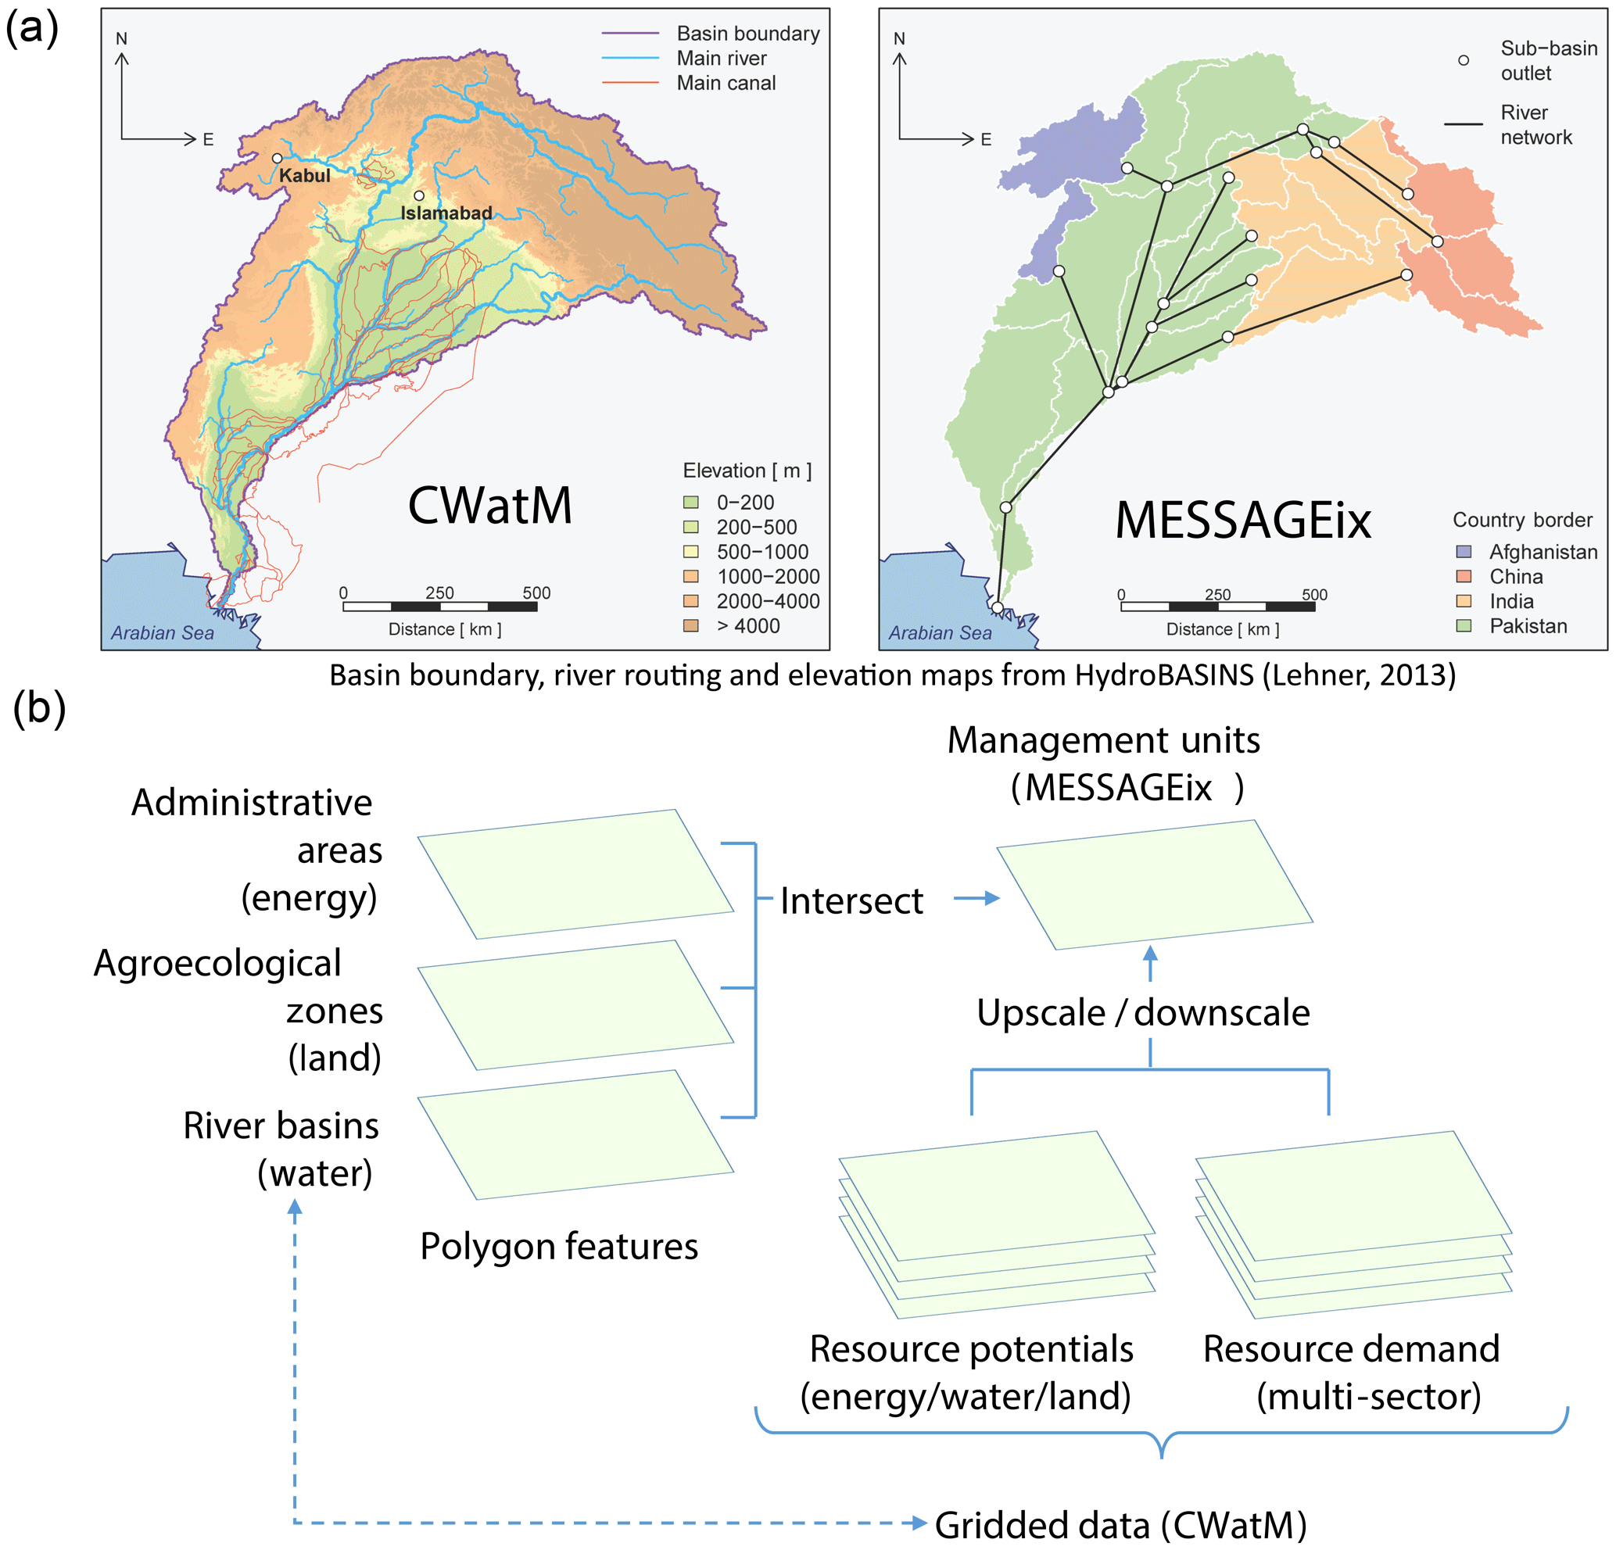
Case Study: Energy-Water-Land Nexus in Indus River Basin
Analysis of the Indus River basin to capture important interlinkages across system transformation pathways towards the UN SDGs
Constraints on land and water availability push the system to make transformational changes to the development pathway for each sector
The transformation can drastically change the structure of the energy and water supplies and land-use pattern
Notes:
Vinca, A., Parkinson, S., Byers, E., Burek, P., Khan, Z., Krey, V., Diuana, F. A., Wang, Y., Ilyas, A., Köberle, A. C., Staffell, I., Pfenninger, S., Muhammad, A., Rowe, A., Schaeffer, R., Rao, N. D., Wada, Y., Djilali, N., & Riahi, K. (2020). The NExus Solutions Tool (NEST) v1.0: an open platform for optimizing multi-scale energy–water–land system transformations. Geoscientific Model Development, 13(3), 1095–1121. https://doi.org/10.5194/gmd-13-1095-2020

Slide 19
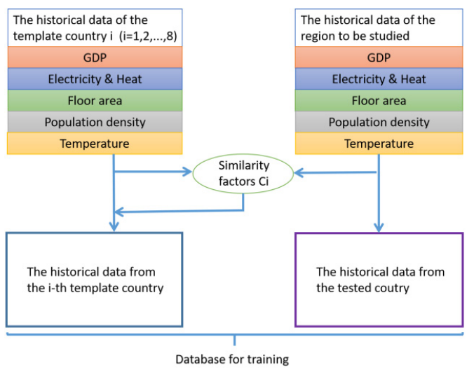
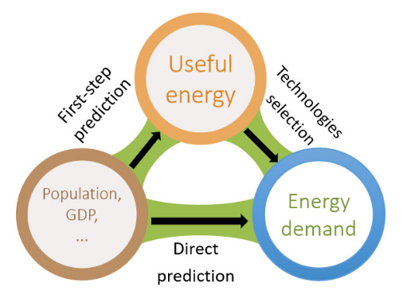
Case Study: Energy Demand Prediction of the Building Sector
The paper presents the method for calculating the useful energy demand in the Chinese building sector and applies this to MESSAGEix for final energy demand
The demand of useful energy is related to the driver indicators such as GDP, population density, floor space per capita and annual average temperature
The final energy prediction shows that the total demand of building sector may reach 3.9 Gtoe/year in 2050
Notes:
Xin, T., Zijian, Z., Changyi, L., Shining, Z., Xing, C., Fangxin, H., Fang, Y., TAN, X., ZHAO, Z., LIU, C., ZHANG, S., CHEN, X., HOU, F., YANG, F., & GUO, F. (2019). Energy Demand Prediction of the Building Sector Based on Induced Kernel Method and MESSAGEix Model. CHINESE JOURNAL OF URBAN AND ENVIRONMENTAL STUDIES, 7(4), 1950016. https://doi.org/10.1142/S2345748119500167

Slide 20
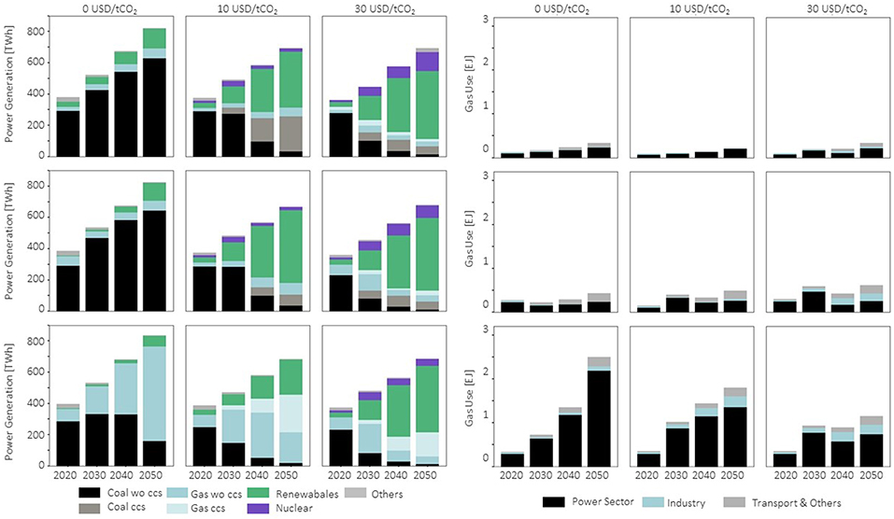
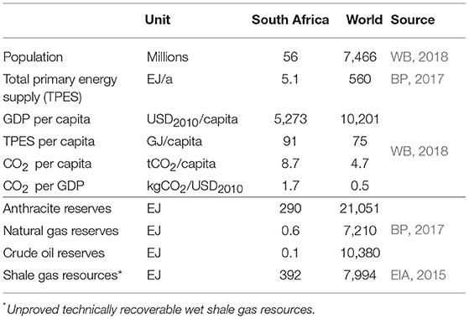
Case Study: Potential Role of Shale Gas for Energy Transition
The paper explores the potential role of shale gas for South Africa to achieve carbon sequestration by reducing reliance on coal for residential, transport and industrial sectors.
The no-shale-gas scenarios show the contribution of carbon prices to climate mitigation
Shale gas scenarios should have variable extraction costs to lie well below 3 USD/GJ to have a large contribution
(Left) Power generation and (Right) gas utilization in nine selected scenarios featuring three different carbon prices (from left to right: 0, 10, and 30USD/tCO2), a scenario set without shale gas (top) and two sets at variable shale gas extraction costs (center: 3USD/GJ, bottom: 1USD/GJ).
Notes:
Orthofer, C. L., Huppmann, D., & Krey, V. (2019). South Africa After Paris—Fracking Its Way to the NDCs? Frontiers in Energy Research, 7. https://doi.org/10.3389/fenrg.2019.00020

Slide 21
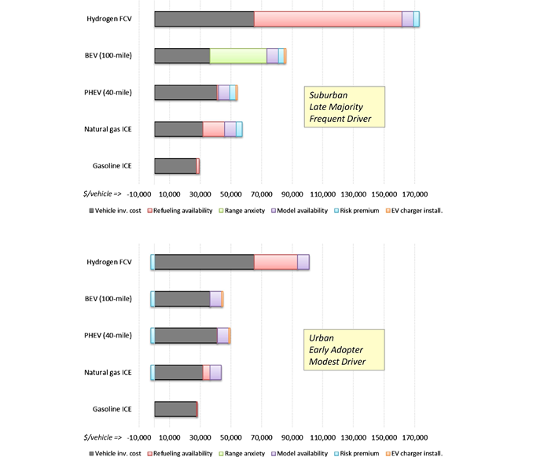
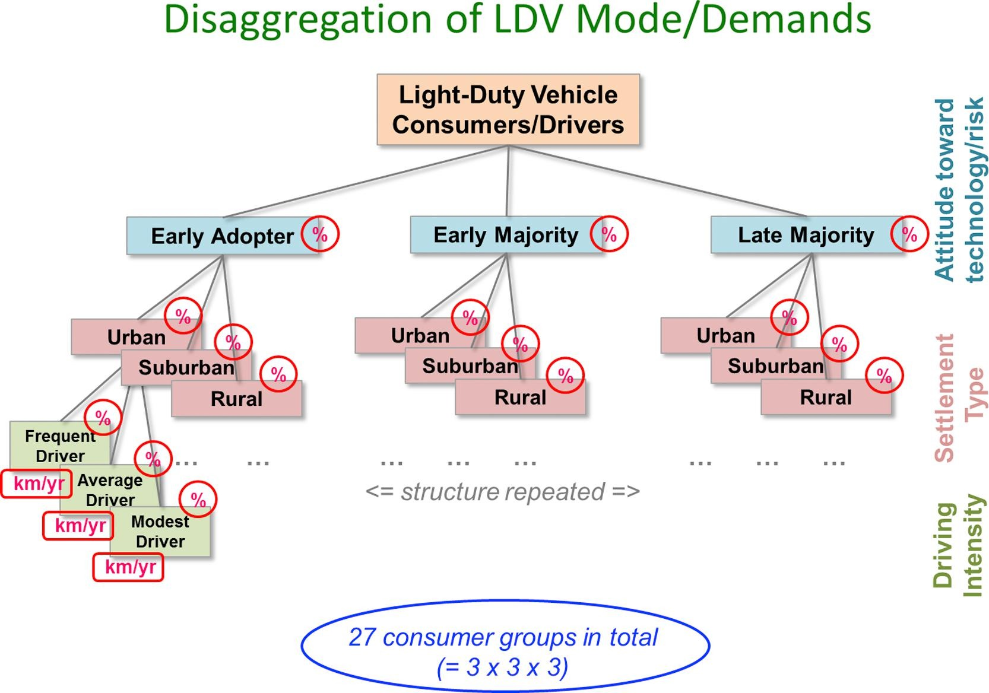
Case Study: Behavioral Attributes in Light Duty Vehicle Sector
The paper assesses the impact of consumer decisions for preference of light duty vehicles which can be linked with behavioral economics.
Contingent valuation using discrete choice experiments may evaluate customer preferences based on non-monetary attributes.
The heterogeneity of the consumers mayy require higher carbon prices for climate mitigation.
Notes:
ICE: internal combustion engine, PHEV: plug-in hybrid electric vehicles, BEV: battery-electric vehicles, FCV: fuel-cell vehicles
McCollum, D. L., Wilson, C., Pettifor, H., Ramea, K., Krey, V., Riahi, K., Bertram, C., Lin, Z., Edelenbosch, O. Y., & Fujisawa, S. (2017). Improving the behavioral realism of global integrated assessment models: An application to consumers’ vehicle choices. Transportation Research Part D: Transport and Environment, 55, 322–342. https://doi.org/10.1016/j.trd.2016.04.003

Slide 22
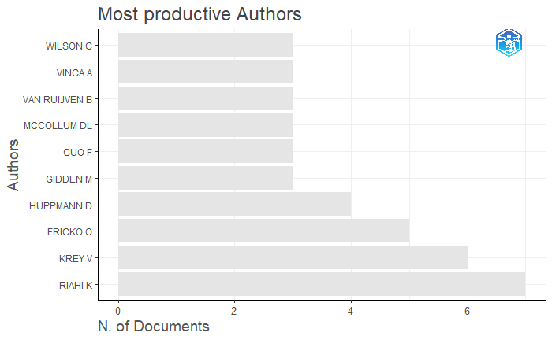
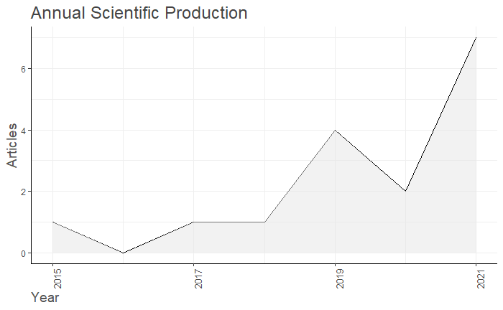
Some Statistics: Bibliometrix

Slide 23
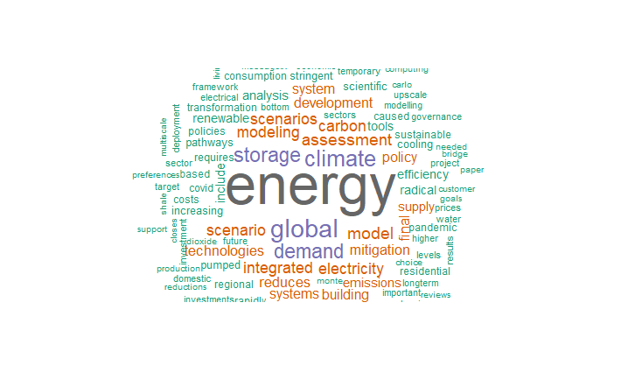
Some statistics: LitsearchR

Slide 24

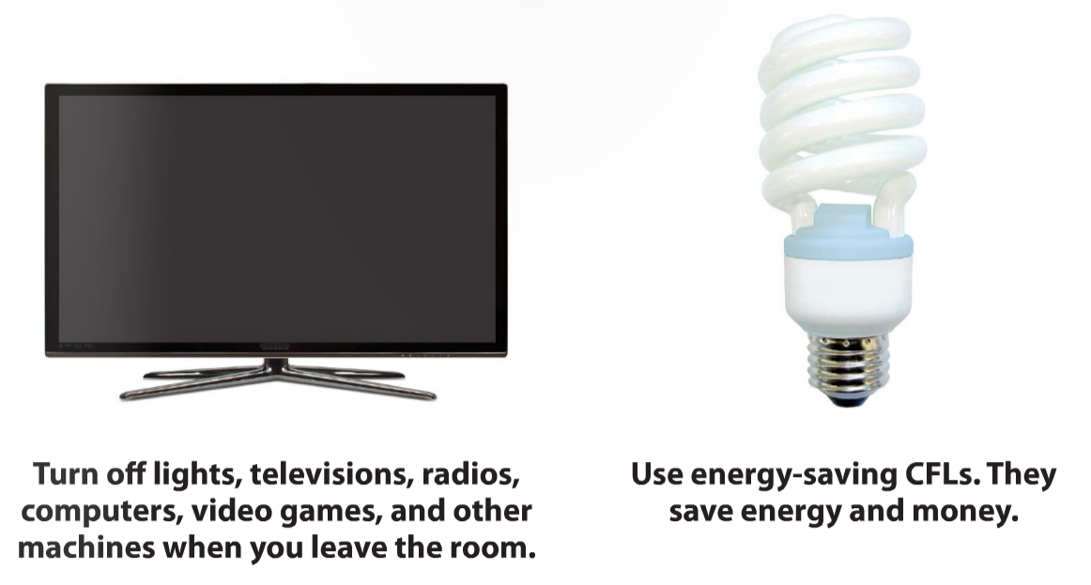

Quiz #3 (Take-home)
Energy system models focus increasingly on energy demand and energy efficiency practices?
How, if at all, do you think we can include energy demand and energy efficiency practices to energy system models?
Open with the take home message (most important thing to share)
Q1: Why are we here?
Q2: Says who (if you use outside sources, please cite them) ?
Q3: So what?
Notes:
https://news.mit.edu/2015/optimizing-optimization-algorithms-0121
https://www.researchgate.net/figure/Socio-economic-optimization-of-network-security_fig1_306355031
https://www.mdpi.com/2079-9292/8/7/799/htm
https://user.eng.umd.edu/~austin/ence202.d/optimization.html

Slide 25
References
[1] Huppmann D, Gidden M, Fricko O, Kolp P, Orthofer C, Pimmer M, et al. The MESSAGE Integrated Assessment Model and the ix modeling platform (ixmp): An open framework for integrated and cross-cutting analysis of energy, climate, the environment, and sustainable development. Environ Model Softw [Internet]. 2019. 112(March 2018):143–56.
[2] Kikstra JS, Vinca A, Lovat F, Boza-Kiss B, van Ruijven B, Wilson C, et al. Climate mitigation scenarios with persistent COVID-19-related energy demand changes. Nat Energy. 2021. 6(12):1114–23.
[3] van Soest HL, Aleluia Reis L, Baptista LB, Bertram C, Després J, Drouet L, et al. Global roll-out of comprehensive policy measures may aid in bridging emissions gap. Nat Commun [Internet]. 2021. 12(1):6419.
[4] Zhou W, McCollum DL, Fricko O, Gidden M, Huppmann D, Krey V, et al. A comparison of low carbon investment needs between China and Europe in stringent climate policy scenarios. Environ Res Lett [Internet]. 2019. 14(5):054017.
[5] Grubler A, Wilson C, Bento N, Boza-Kiss B, Krey V, McCollum DL, et al. A low energy demand scenario for meeting the 1.5 °C target and sustainable development goals without negative emission technologies. Nat Energy [Internet]. 2018. 3(6):515–27.
[6] Zakeri B, Syri S. Electrical energy storage systems: A comparative life cycle cost analysis. Renew Sustain Energy Rev [Internet]. 2015. 42:569–96.
[7] Martins F, Patrão C, Moura P, de Almeida AT. A Review of Energy Modeling Tools for Energy Efficiency in Smart Cities. Smart Cities [Internet]. 2021. 4(4):1420–36.
[8] Zhao F, Fan Y, Zhang S. Assessment of efficiency improvement and emission mitigation potentials in China’s petroleum refining industry. J Clean Prod [Internet]. 2021. 280(2):124482.
[9] Mastrucci A, van Ruijven B, Byers E, Poblete-Cazenave M, Pachauri S. Global scenarios of residential heating and cooling energy demand and CO2 emissions. Clim Change [Internet]. 2021. 168(3–4):14.
[10] Jie D, Xu X, Guo F. The future of coal supply in China based on non-fossil energy development and carbon price strategies. Energy [Internet]. 2021. 220:119644.
[11] Hunt JD, Weber N de AB, Zakeri B, Diaby AT, Byrne P, Filho WL, et al. Deep seawater cooling and desalination: Combining seawater air conditioning and desalination. Sustain Cities Soc. 2021. 74(August).
[12] Ghadaksaz H, Saboohi Y. Energy supply transformation pathways in Iran to reduce GHG emissions in line with the Paris Agreement. Energy Strateg Rev [Internet]. 2020. 32:100541.
[13] Vinca A, Parkinson S, Byers E, Burek P, Khan Z, Krey V, et al. The NExus Solutions Tool (NEST) v1.0: an open platform for optimizing multi-scale energy–water–land system transformations. Geosci Model Dev [Internet]. 2020. 13(3):1095–121.
[14] Xin T, Zijian Z, Changyi L, Shining Z, Xing C, Fangxin H, et al. Energy Demand Prediction of the Building Sector Based on Induced Kernel Method and MESSAGEix Model. CHINESE J URBAN Environ Stud. 2019. 7(4):1950016.
[15] Orthofer CL, Huppmann D, Krey V. South Africa After Paris—Fracking Its Way to the NDCs? Front Energy Res [Internet]. 2019. 7.
[16] McCollum DL, Wilson C, Pettifor H, Ramea K, Krey V, Riahi K, et al. Improving the behavioral realism of global integrated assessment models: An application to consumers’ vehicle choices. Transp Res Part D Transp Environ [Internet]. 2017. 55:322–42.

